Slide 1
Fraud Prevention & Detection Technologies
Relative Size Tests using Excel

Slide 2
Group 12
School of Applied Sciences and Education
ICT Department
Cyber Security
STUDENT NAME | STUDENT NUMBER
James Soko | 20231392
Cuthbelt Ndhlovu | 20231784
Courage Silweya | 20230099
Esther Ngoma | 20230442
Alice M. Chota | 22175367
Alinet Hang’oba | 20231685

Slide 3
Question
Objective: Compare item sizes to benchmarks (e.g., transactions > 3x average).
Deliverables:
Z-score/percentile analysis.
A report on "unusually large" items.
Example: Flag Ponzi scheme pay-outs (e.g., 10x typical returns).

Slide 4
Objectives
Understanding the term data set.
Understanding the term mean and how to calculate it.
Understanding Standard Deviation and how to use the formula.
Understanding Zero-score and how to calculate the Standard Score.
Understanding how to integrate the data set and use AVERAGE, STDEV, PECENTRANK.INC, IF, and COUNTIF functions in Excel.
Understanding how to calculate Zero-score for each transaction in Excel.
Understanding how to use the above tools or methods in Fraud Prevention & Detection Technologies.

Slide 5
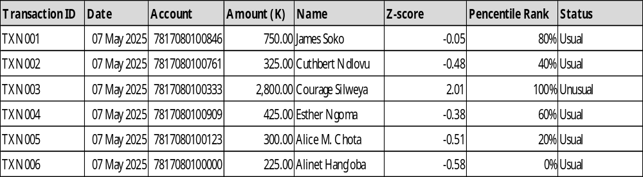
Data Set
A data set is a collection of related data, often organized in a structured format like a table or spreadsheet, used for analysis, model training, or other purposes.

Slide 6
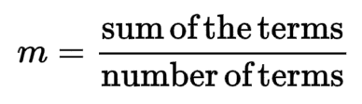
Mean
Mean is the average of the given numbers.
The formula for the Mean is
μ = 750+325+2800+425+300+225 ÷ 6
= 4825 ÷ 6
= 804.16
The mean (m) for the data set given is 804.16 for the transactions.

Slide 7
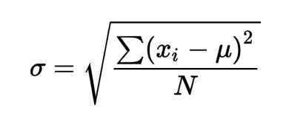
Standard deviation
Standard Deviation is a quantity expressing by how much the members of a group differ from the mean value for the group.
The formula for the Standard Deviation is
σ = dataset standard deviation
N = the size of the dataset
Xί = each value from the dataset
μ = the dataset mean (m)

Slide 8
Standard deviation
Formula
μ = 750+325+2800+425+300+225 ÷ 6
= 4825 ÷ 6
= 804.16
N = 6
Sub-standard Deviations
750-804.16 = -54.16
325-804.16 = -479.16
2800-804.16 = 1995.84
425-804.16 = -379.16
300-804.16 = -504.16
225-804.16 = -579.16

Slide 9
Standard deviation
Sub-standard Deviations²
-54.16² = 2933.30
-479.16² = 229594.30
1995.84² = 3983377.30
-379.16² = 143762.30
-504.16² = 254177.30
-579.16² = 335426.30
Summation
∑ = (2933.30+ 229594.30+ 3983377.30+ 143762.30+ 254177.30+ 335426.30)
∑ = 4949270.8
∑÷N = 824878.46
✓ 824878.46 = 908.22

Slide 10
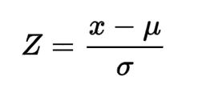
Standard Score
The Z-score measures how many standard deviations a value is from the mean.
The formula for the Standard Score or Z-score is
Z = standard score
X = observed value
μ​ = mean of the dataset (m)
σ = standard deviation of the dataset

Slide 11
Standard Score
Formula
= 750-804.16 ÷ 908.22
= -54.16÷908.22
= -0.05
Therefore -0.05 is the Standard Score for James’s transaction (K750)
Now let’s use Excel to find all the Zero-score values as shown below
Amount (K) | Name | Z-score
750.00 | James Soko | -0.5
325.00 | Cuthbert Ndlovu | -0.48
2800.00 | Courage Silweya | 2.01
425.00 | Esther Ngoma | -0.38
300.00 | Alice M. Chota | -0.51
225.00 | Alinet Han’goba | -0.58

Slide 12
Percentile Rank
A percentile score tells you the relative standing of a value in a dataset.
In fraud detection, very high percentile scores (e.g., above the 95th, 98th, or 99th percentile) often signal unusually large or suspicious transactions, which may warrant investigation.
Percentile Rank | Interpretation | Action
< 90 | Normal Range | No action
90 – 95 | Mildly Unusual | Flag for review
> 95 | Unusual (possible red flag) | Investigate for fraud
> 99 | Very rare (likely suspicious) | Investigate for high fraud risk

Slide 13
Excel
Excel is a spreadsheet program from Microsoft used for organizing, analyzing, and visualizing data.
Download the excel lab here.
Formulas used:
Mean =AVERAGE(D5:D10)
Standard Deviation =STDEV.S(D5:D10)
Z-score =(D5 - $K$5)/($K$6)
Pecentile Rank =PERCENTRANK.INC($D$5:$D$10, D5)

Slide 14
Excel
Filter =FILTER(A5:H10,H5:H10=D14,"No search as been made or zero results")
Count if
=COUNTIF(H5:H10,"Usual")
=COUNTIF(H5:H10,"Unusual")

Slide 15
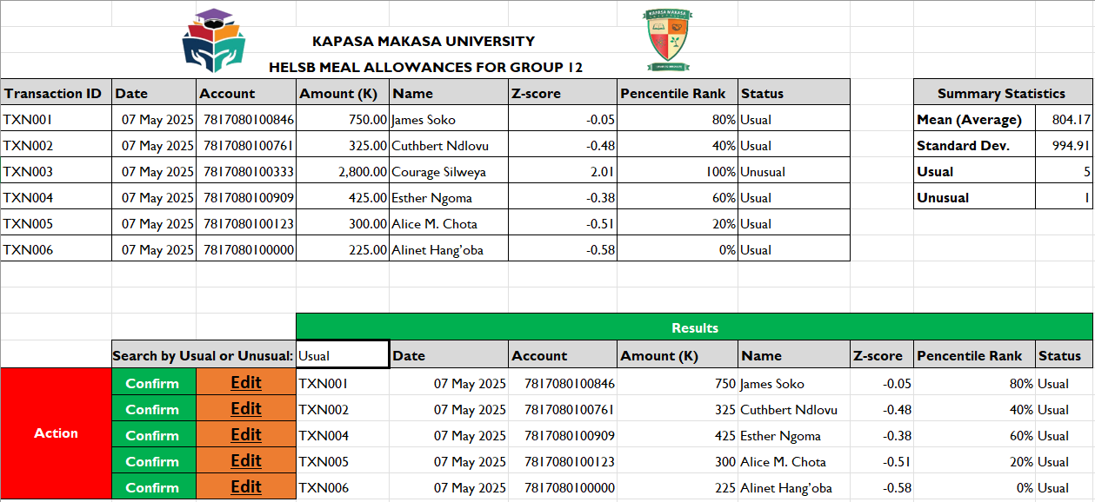
Excel Lab: Relative Size Tests for Fraud Detection
Analyzing transaction data to flag potentially fraudulent activity using Z-scores and relative size thresholds (e.g., Z-score > 2 or 2× average).

Slide 16
Fraud Detection & Prevention Technologies
Fraud detection technologies include tools, methods, and systems used to identify suspicious or unauthorized activities (like money laundering, embezzlement, Ponzi schemes, or invoice fraud).
These may include: Data analytics tools (like ACL, IDEA, Excel)
Relative Size Test (RST) as a Detection Tool helps detect outliers by flagging transactions that are:
Statistically unusual (e.g., Z-score > 2)
Disproportionately large compared to peer values (e.g., >2× average)
Beyond a defined percentile threshold (e.g., >99th percentile)

